Slide 1
Data Science Ecosystem

Slide 2
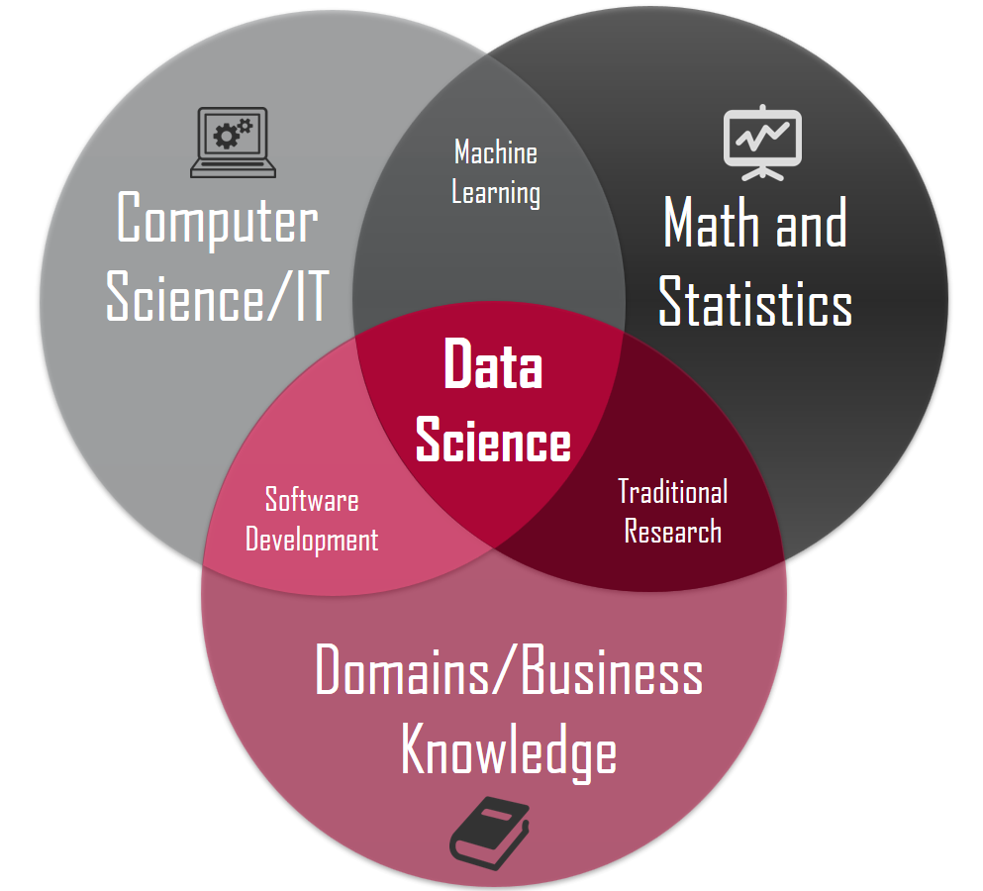
What is Data Science
https://towardsdatascience.com/introduction-to-statistics-e9d72d818745
Blend of various principles from Algorithms, Software Engineering, Programming, Algebra, Calculus, Statistics and Probability with the goal to discover hidden patterns from the raw data that is relevant to a given objective function

Slide 3
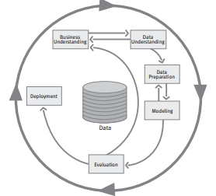
CRISP-DM* reference model
A structured approach to planning a data mining project
Business understanding Objectives Selection of tools and techniques Evaluation Criteria Data understanding Identify and describe required data sets Explore and visualize Verify quality Address quality issues Data preparation Select most relevant sources Clean data sets Transform data sets Integrate sources | Modeling Select appropriate data analytics / learning model Generate test plan Build and assess model Evaluation Evaluate results Review process Deployment Deployment Plan Monitor and Upgrade
*Cross-industry standard process for data mining
Chapman, Pete, et al. "CRISP-DM 1.0 Step-by-step data mining guide." (2000).

Slide 4
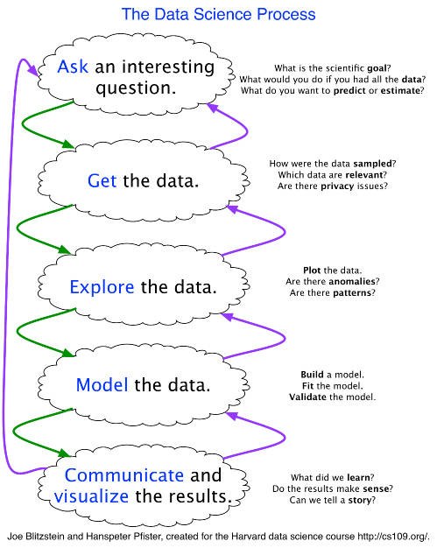
Data Science Process (1/5)
Stage 1: Ask A Question
Skills: science, domain expertise, curiosity
Tools: your brain, talking to experts, experience
Stage 2: Get the Data
Skills: web scraping, data cleaning, querying databases, CS stuff
Tools: python, pandas
Stage 3: Explore the Data
Skills: Get to know data, develop hypotheses, patterns? Anomalies?
Tools: matplotlib, numpy, scipy, pandas
Stage 4: Model the Data
Skills: regression, machine learning, validation, big data
Tools: scikit learn, pandas, mrjob, mapreduce
Stage 5: Communicate the Data
Skills: presentation, speaking, visuals, writing
Tools: matplotlib, adobe illustrator, powerpoint/keynote
https://www.kdnuggets.com/2016/03/data-science-process-rediscovered.html

Slide 5
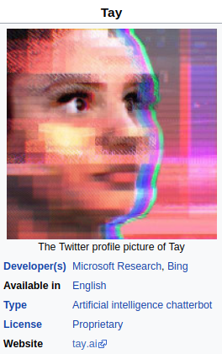
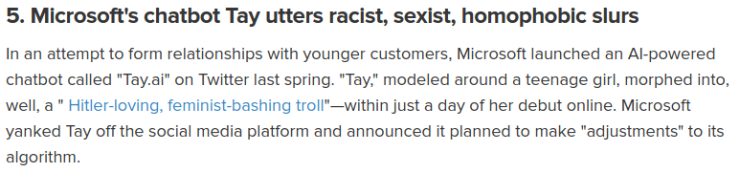
Data Science Process (2/5)
Borenstein, Jason, and Ronald C. Arkin. "Nudging for good: robots and the ethical appropriateness of nurturing empathy and charitable behavior." AI & SOCIETY 32.4 (2017): 499-507.

Slide 6

Data Science Process (3/5)

Slide 7

Data Science Process (4/5)
https://intelligent-information.blog/en/blog/2018/02/22/garbage-in-garbage-out-intelligent-information-3-conditions/

Slide 8
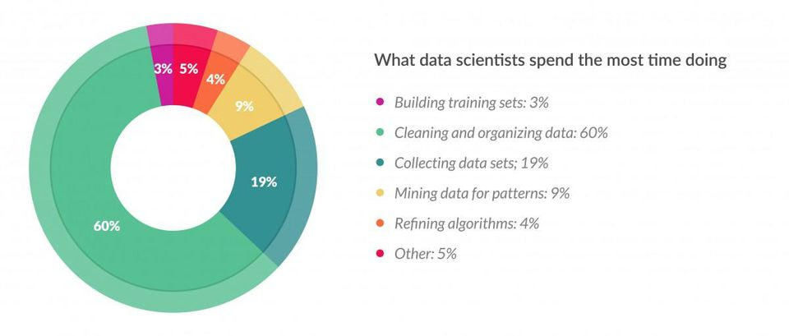
Data Science Process (5/5)
https://www.forbes.com/sites/gilpress/2016/03/23/data-preparation-most-time-consuming-least-enjoyable-data-science-task-survey-says/#51249c146f63

Slide 9
Why Python
Interpreted Language for rapid prototyping
One of the most important languages for data science, machine learning and general software development
Ease of integrating with C, C++ and FORTRAN code
Allows utilization of low level system code and drivers
Availability of large ecosystem of addons

Slide 10
Essential Python Libraries (1/2)
NumPy (Numerical Python)
Cornerstone of numerical computing in Python
Fast array processing capabilities
Pandas (panel data)
Designed to work with structured or tabular data in fast, easy and expressive manner
Provides high-level data structures and functions
Provides integration and interoperability with NumPy

Slide 11
Essential Python Libraries (2/2)
Matplotlib
Producing plots and other two dimensional data visualization
Seaborn: extension on matplotlib to provide high-level interface for drawing attractive and informative statistical graphics.
Scikit-learn
Premier general-purpose machine learning toolkit for python programmers
OpenAI Project, Tensorflow, PyTorch

Slide 12
Python Installation
Install from https://www.python.org/
Version 3.9
Ensure pip3 is installed

Slide 13

Python Basics
Python Interpreter
Executes one statement at a time
Standard interpreter shell can be invoked by using the python invoked on your terminal
In order to exit, exit() is invoked in the python interpreter shell

Slide 14
Python Basics
Python script
copy following into text editor and save as hello.py
run as python hello.py
run as python hello.py new
run as python hello.py new world
run as python hello.py new world 123
#!/usr/bin/python import sys filename=sys.argv[0] args = sys.argv[1:] if len(args) == 0: args = ['hello,', 'world!'] elif len(args) == 1: args.append('world!') print(args[0], args[1])

Slide 15
Visual Studio Code (VSCode)
Default IDE
Install from https://code.visualstudio.com/
Version 1.59
Integrated Python Development Environment
With Jupyter Notebook Extension

Slide 16
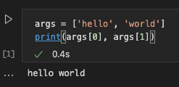
VSCode Jupyter Notebook Extension (1/8)
Install Jupyter package for Python
Execute in your terminal, shell or bash: pip install jupyter
Install Jupyter Notebook Extension from Microsoft for VSCode
Click View->Extensions and search for: @id:ms-toolsai.jupyter
Create a new file with .ipynb extension (e.g.: start.ipynb)
Open the file in VSCode using the Jupyter Notebook extension
Setup the python 3.9.* as the default python interpreter in VSCode
Click View->Command Palette and execute the statement: Python: Select Interpreter and choose Python 3.9.* [64/32]-bit
Click on the empty cell and enter the following
Click Run button to run the cell

Slide 17
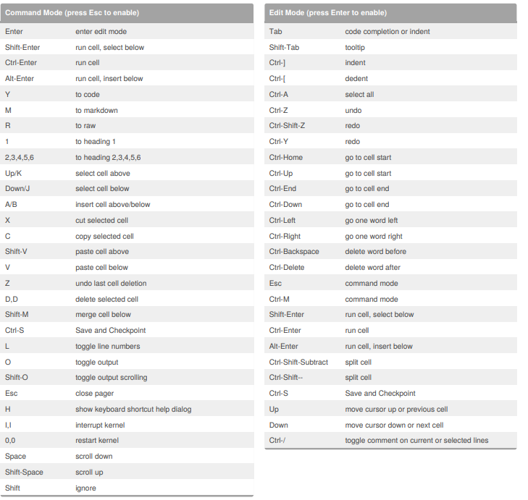
VSCode Jupyter Notebook Extension (2/8)
Keyboard Cheat Sheet
https://www.cheatography.com/weidadeyue/cheat-sheets/jupyter-notebook/pdf_bw/

Slide 18
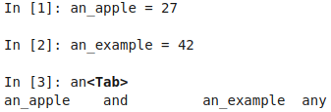
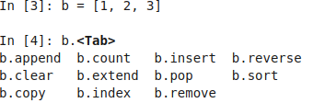
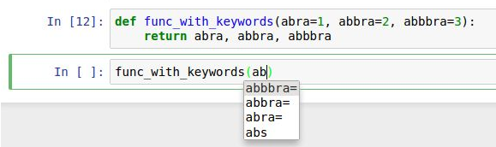
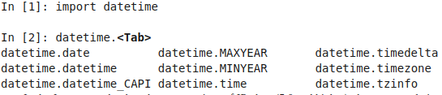
VSCode Jupyter Notebook Extension (3/8)
Tab Completion
Namespace: Object, Function
Methods and attributes
Modules
Tab Completion
File paths
Function arguments

Slide 19
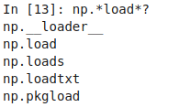
VSCode Jupyter Notebook Extension (4/8)
Introspection
? after a variable, object or function will display some general information
?? will also show the functions source code
? can also be used to search the namespace

Slide 20

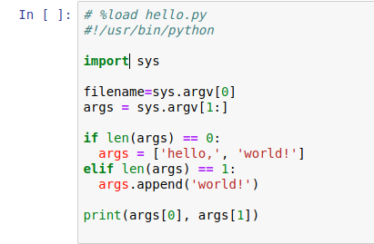
VSCode Jupyter Notebook Extension (5/8)
Magic commands %
%run command: runs a file on local filesystem.
%load command loads a script into a cell from the local filesystem
%load hello.py will result into

Slide 21
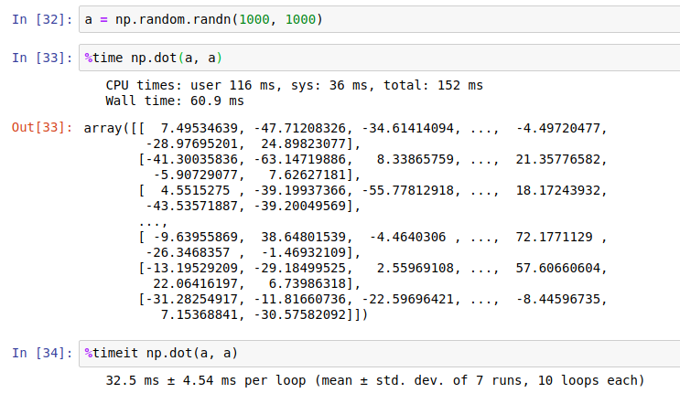
VSCode Jupyter Notebook Extension (6/8)
Magic commands %
%time command: measures the execution time by running a statement once
%timeit command: measure the execution time by running a statement multiple times. More precise, but takes longer

Slide 22
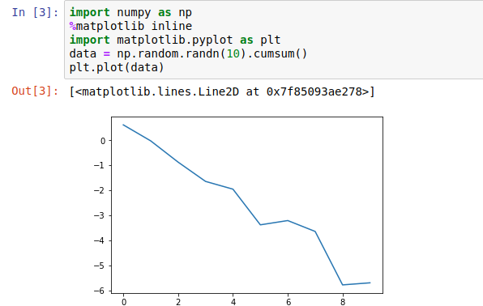
VSCode Jupyter Notebook Extension (7/8)
Magic commands %
Matplotlib integration
%matplotlib inline command configures integration with Jupyter Notebook

Slide 23
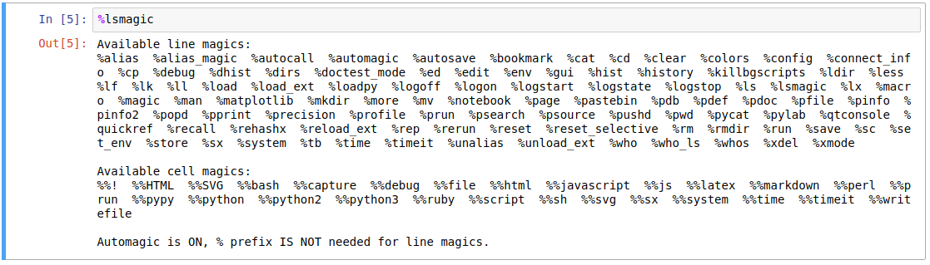
VSCode Jupyter Notebook Extension (8/8)
All % Magic Commands
Further read: https://ipython.readthedocs.io/en/stable/interactive/magics.html

Slide 24
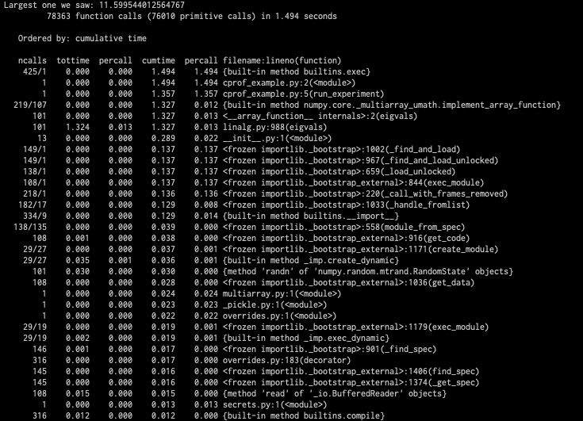
Profiling (1/3)
Related to timing code, except it determines where time is spent for a whole python script
Download cprof_example.py file
From terminal execute:
python -m cProfile -s cumulative cprof_example.py
Output is sorted by cumulative time spent on a particular call

Slide 25
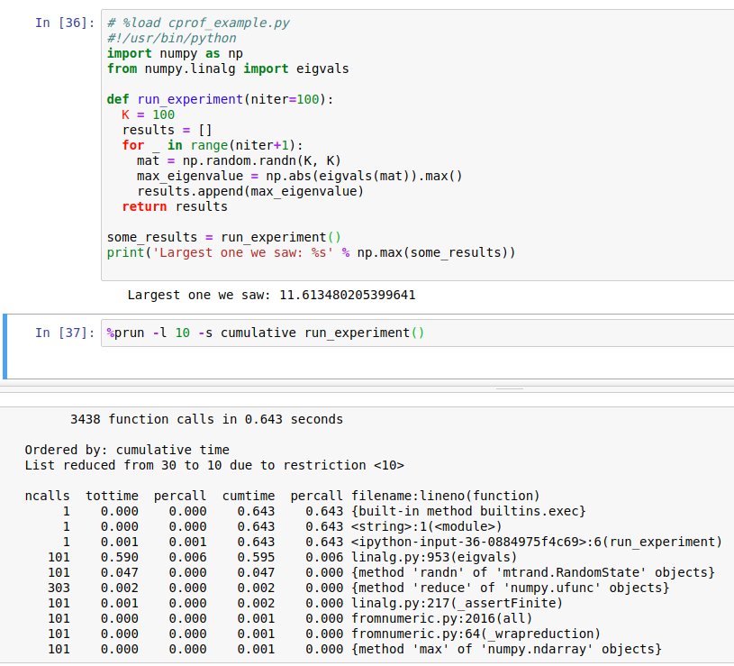
Profiling (2/3)
Profiling can also be run from Jupyter Notebook using Magic commands %
%prun command: Related to timing code, except it determines where time is spent for a python statement or function
-l 10: limits the number of lines that are displayed
%%prun magic command can be used at the top of a code block/cell to profile the entire block
Example: %%prun -s cumulative -l 10

Slide 26
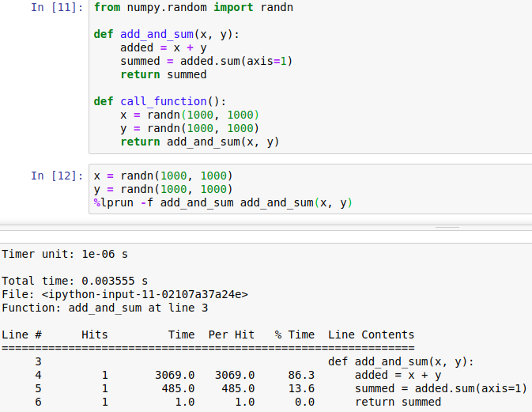
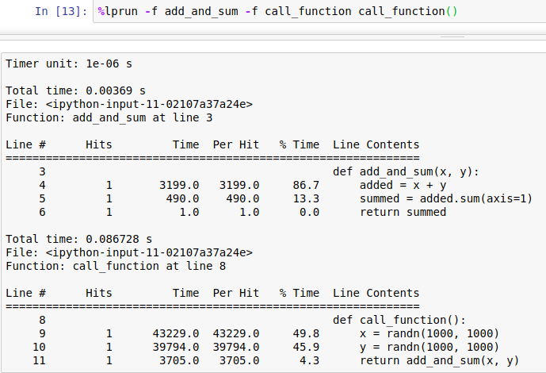
Profiling (3/3)
Line Profiler: provides a simple line by line profiling of one or more functions
External package: can be installed by executing in your terminal:
pip3 install line_profile
Needs to be enabled in Jupyter Notebook
%load_ext line_profiler
Needs to provide which function or functions are to be profiled
%lprun -f func1 -f func2 statement_to profile
Explicit specification of func names are required to reduce overhead of “tracing” the dependent functions

